Slide 1

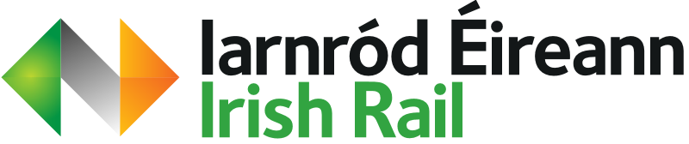

IRISH RAIL TRANSFORMATION
TEAM ARCVISION
R.V College of Engineering
Friday, 13 June 2025

Slide 2





The Crew
Rohan J S
Prajwal M
Kushaal S
Pranav D

Slide 3
Introduction
Iarnród Éireann Irish Rail is undergoing a visionary transformation to become a data-driven, future-ready enterprise. With passenger numbers expected to grow by over 160%—from 48 million in 2018 to 126 million by 2040, the adoption of smart infrastructure is accelerating. Already, over 40% more passengers are projected on intercity routes by 2027, highlighting the need for efficient, scalable systems. Modernization projects are generating high-value data from thousands of IoT sensors monitoring train health, seat occupancy, energy use, and emissions. To harness this growth, Irish Rail is implementing a robust Enterprise Reference Architecture aligned with TOGAF. Featuring a Unified Namespace and semantic data hierarchy, the new architecture enables real-time data integration, predictive analytics, and seamless interoperability, offering a significant leap in operational efficiency, safety, and passenger service over legacy systems.

Slide 4
Problem Statement
The transformation projects at Iarnród Éireann Irish Rail are expected to produce large volumes of data from various sources. However, there is currently no standardized reference architecture to manage this data effectively. The absence of such a framework makes it challenging to integrate data sources, collect data efficiently, and analyze and visualize it in a manner that provides actionable insights. Moreover, the complexity and diversity of data can lead to inconsistencies and inefficiencies in data handling and interpretation.

Slide 5
Objectives
Using TOGAF principles to architect a framework to meet the data handling requirements of Irish rail in accordance with the problem statement.
Identify all stakeholders associated with the data transformation.
Design a single source of truth data system which supports interoperability of wide variety of data from different domains.
Utilize modern technologies and standards like Unified namespace (UNS) and semantic hierarchy to architect the data solution.
Architect a technology layer for the data system to work in.
Design supplementary architectures to complement the functioning of technology architecture.
Notes:
supplementary architectures are security architecture and source data policy

Slide 6
Current State Analysis
Representation of the current data architecture of the Irish rail enterprise
No single representation of the current and historic state of the enterprise
The current architecture consists of various data sources and data consumers directly connected to each other without the presence a central data system
Gaps in the current architecture that can be improved upon include scaling capacity, interoperability and readability of data
Notes:
5 min

Slide 7
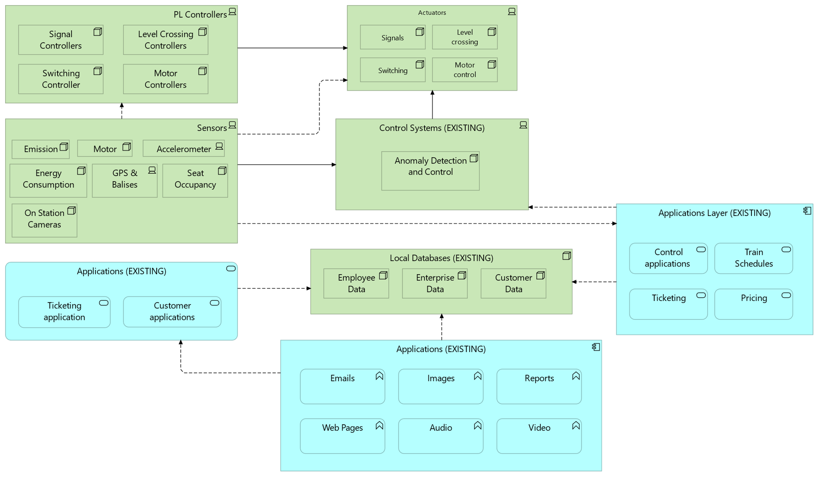
Current State Analysis

Slide 8
Business Architecture
Business Architecture is a structure that connects people, processes, data, and technology to deliver business goals.
Irish Rail Key Focus Areas are,
Unified data ecosystem (via UNS Services)
Real-time operational intelligence
Regulatory & compliance alignment (EU, GDPR, etc.)
Integrated passenger & freight services
Stakeholder-driven decision-making
Notes:
Prajwal

Slide 9
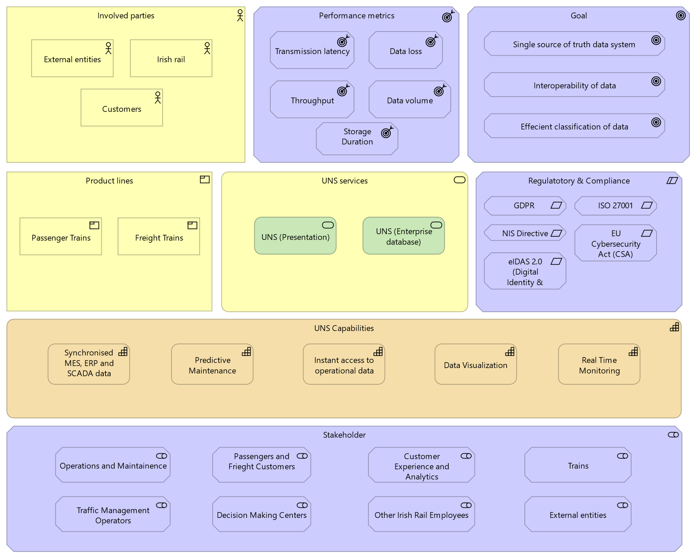
Business Architecture

Slide 10
Business Capability Map
Business Capability map defines what the business must do to achieve its goals (not how).It provides a common language between business and IT.
Enables alignment of digital initiatives with strategic objectives.
Forms the basis for technology investments and process improvements.
In Irish Rail, they support:
A data-driven, customer-focused transformation.
Adoption of Unified Namespace (UNS) for real-time visibility.
Scalable, resilient operations and innovation readiness.
Notes:
Prajwal UNS (unified name space) is core capabilities, and rest are supporting capabilities

Slide 11
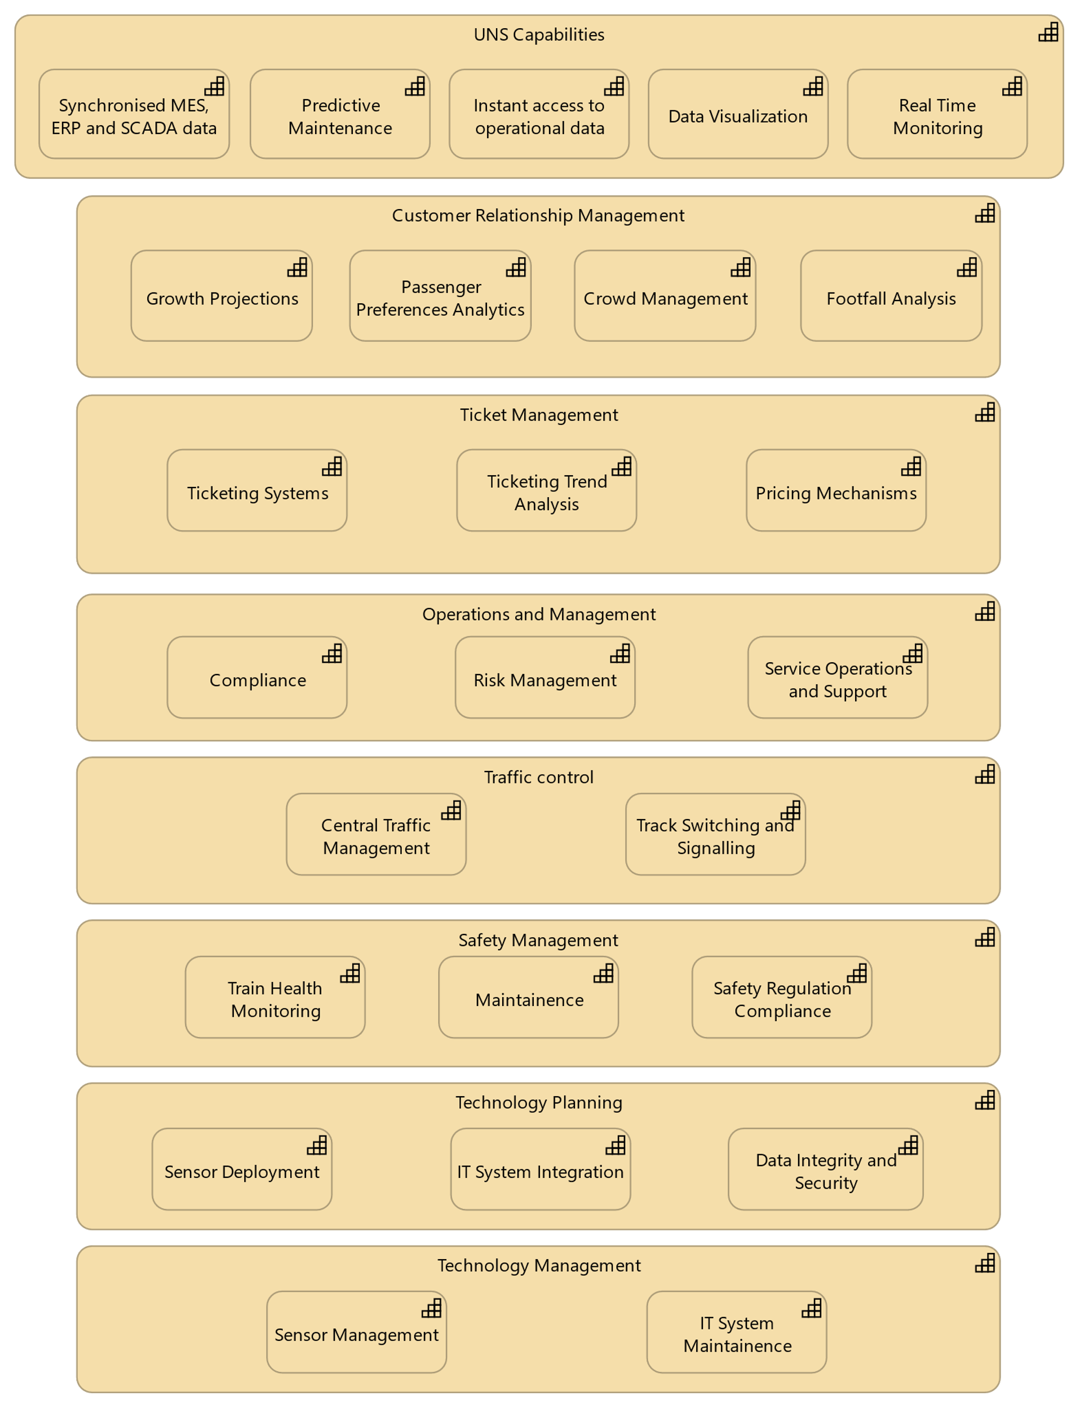
Business Capabilities

Slide 12
Data Architecture
Methods used for data architecture design
Unified namespace(UNS): A single source of truth of all real time enterprise data within the Irish rail enterprise which serves as a data routing mechanism from publishers to subscribers. Designed to be scalable with large loads of data and to be organized efficiently.
Semantic hierarchy: A hierarchy of data within the unified namespace called the UNS topic tree established using standards like the ISA-95 standard enabling the subscribers to be able to efficiently filter out required data and extract them for further use/processing.
Central Data lakes/Database: Single source to store and access all historic and permanent structured, semi structured and unstructured enterprise data for the long term.
Architecting data models: Categorizing how each type of data produced by the data publishers fits into the unified namespace and the semantic hierarchy constructed and how this data can be accessed by the subscribers.
Constructing data flow diagrams: Constructing diagrams that indicate how data will flow from the data publishers to the data subscribers and the data store.
Notes:
mention how UNS ensures that subscribers can only see data the subscriber has subscribed to

Slide 13
Data Architecture
Data sources (Publishers)
1. IOT sensors onboard trains and tracks
GPS and balises
Motor sensors
Accelerometer Seat occupancy data from trains Energy Consumption and Emission Sensors
2. PL Controllers
Signal controllers
Level crossing controllers
Switching controllers
Motor controllers
3. Actuators
Signals Level crossings Switching Motor control
4. Applications
Customer applications
Central monitoring service
Central signaling system
5. Control Systems
Anomaly detection
6. Local Databases
Ticketing databases
Train schedule

Slide 14
Data architecture
Data Subscribers
Databases/Data lake to permanently store data: Centralized data store for historic data of the enterprise
Visualization platforms: Platforms to graphically display real time data from the UNS
Web/Mobile applications: Applications used by any of the stakeholders that require data from the UNS to obtain a picture of the current status of the enterprise
Actuators: Signals and other devices that can be controlled directly through the UNS throughout the entire enterprise
Train onboard unit: Display units on the train displaying speed, location, signal status, etc.
Control systems: Centralized control system that controls signals, track switches, railway crossings etc.

Slide 15
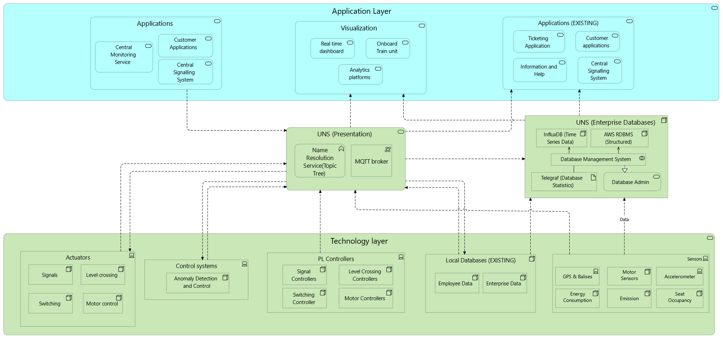
Data Architecture

Slide 16
Data architecture
While the UNS presentation layer deals with forwarding of real time data, it does not provide any data storage capabilities. To represent this, we define a permanent data architecture to represent flow of the data that requires to be stored for the long term.
Notes:
18mins Mention why this architecture is relevant as it deals with data to be stored over a long term

Slide 17
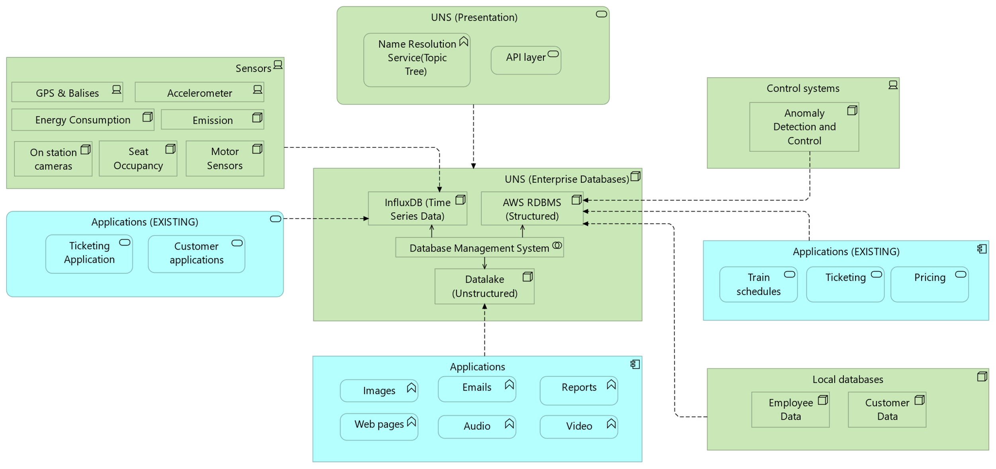
Permanent Data Architecture

Slide 18
Application Architecture
Application Architecture outlines how applications interact to support business capabilities. It promotes modular, scalable, and reusable systems.
Reduces redundancy by consolidating services across domains. Enables integration across legacy and modern systems via APIs.
It supports the deployment of Unified Namespace (UNS) for real-time data flow.
Migration to event-driven, cloud-compatible platforms. Irish Rail’s digital twin, IoT, and automation initiatives.
Notes:
20mins
Prajwal

Slide 19
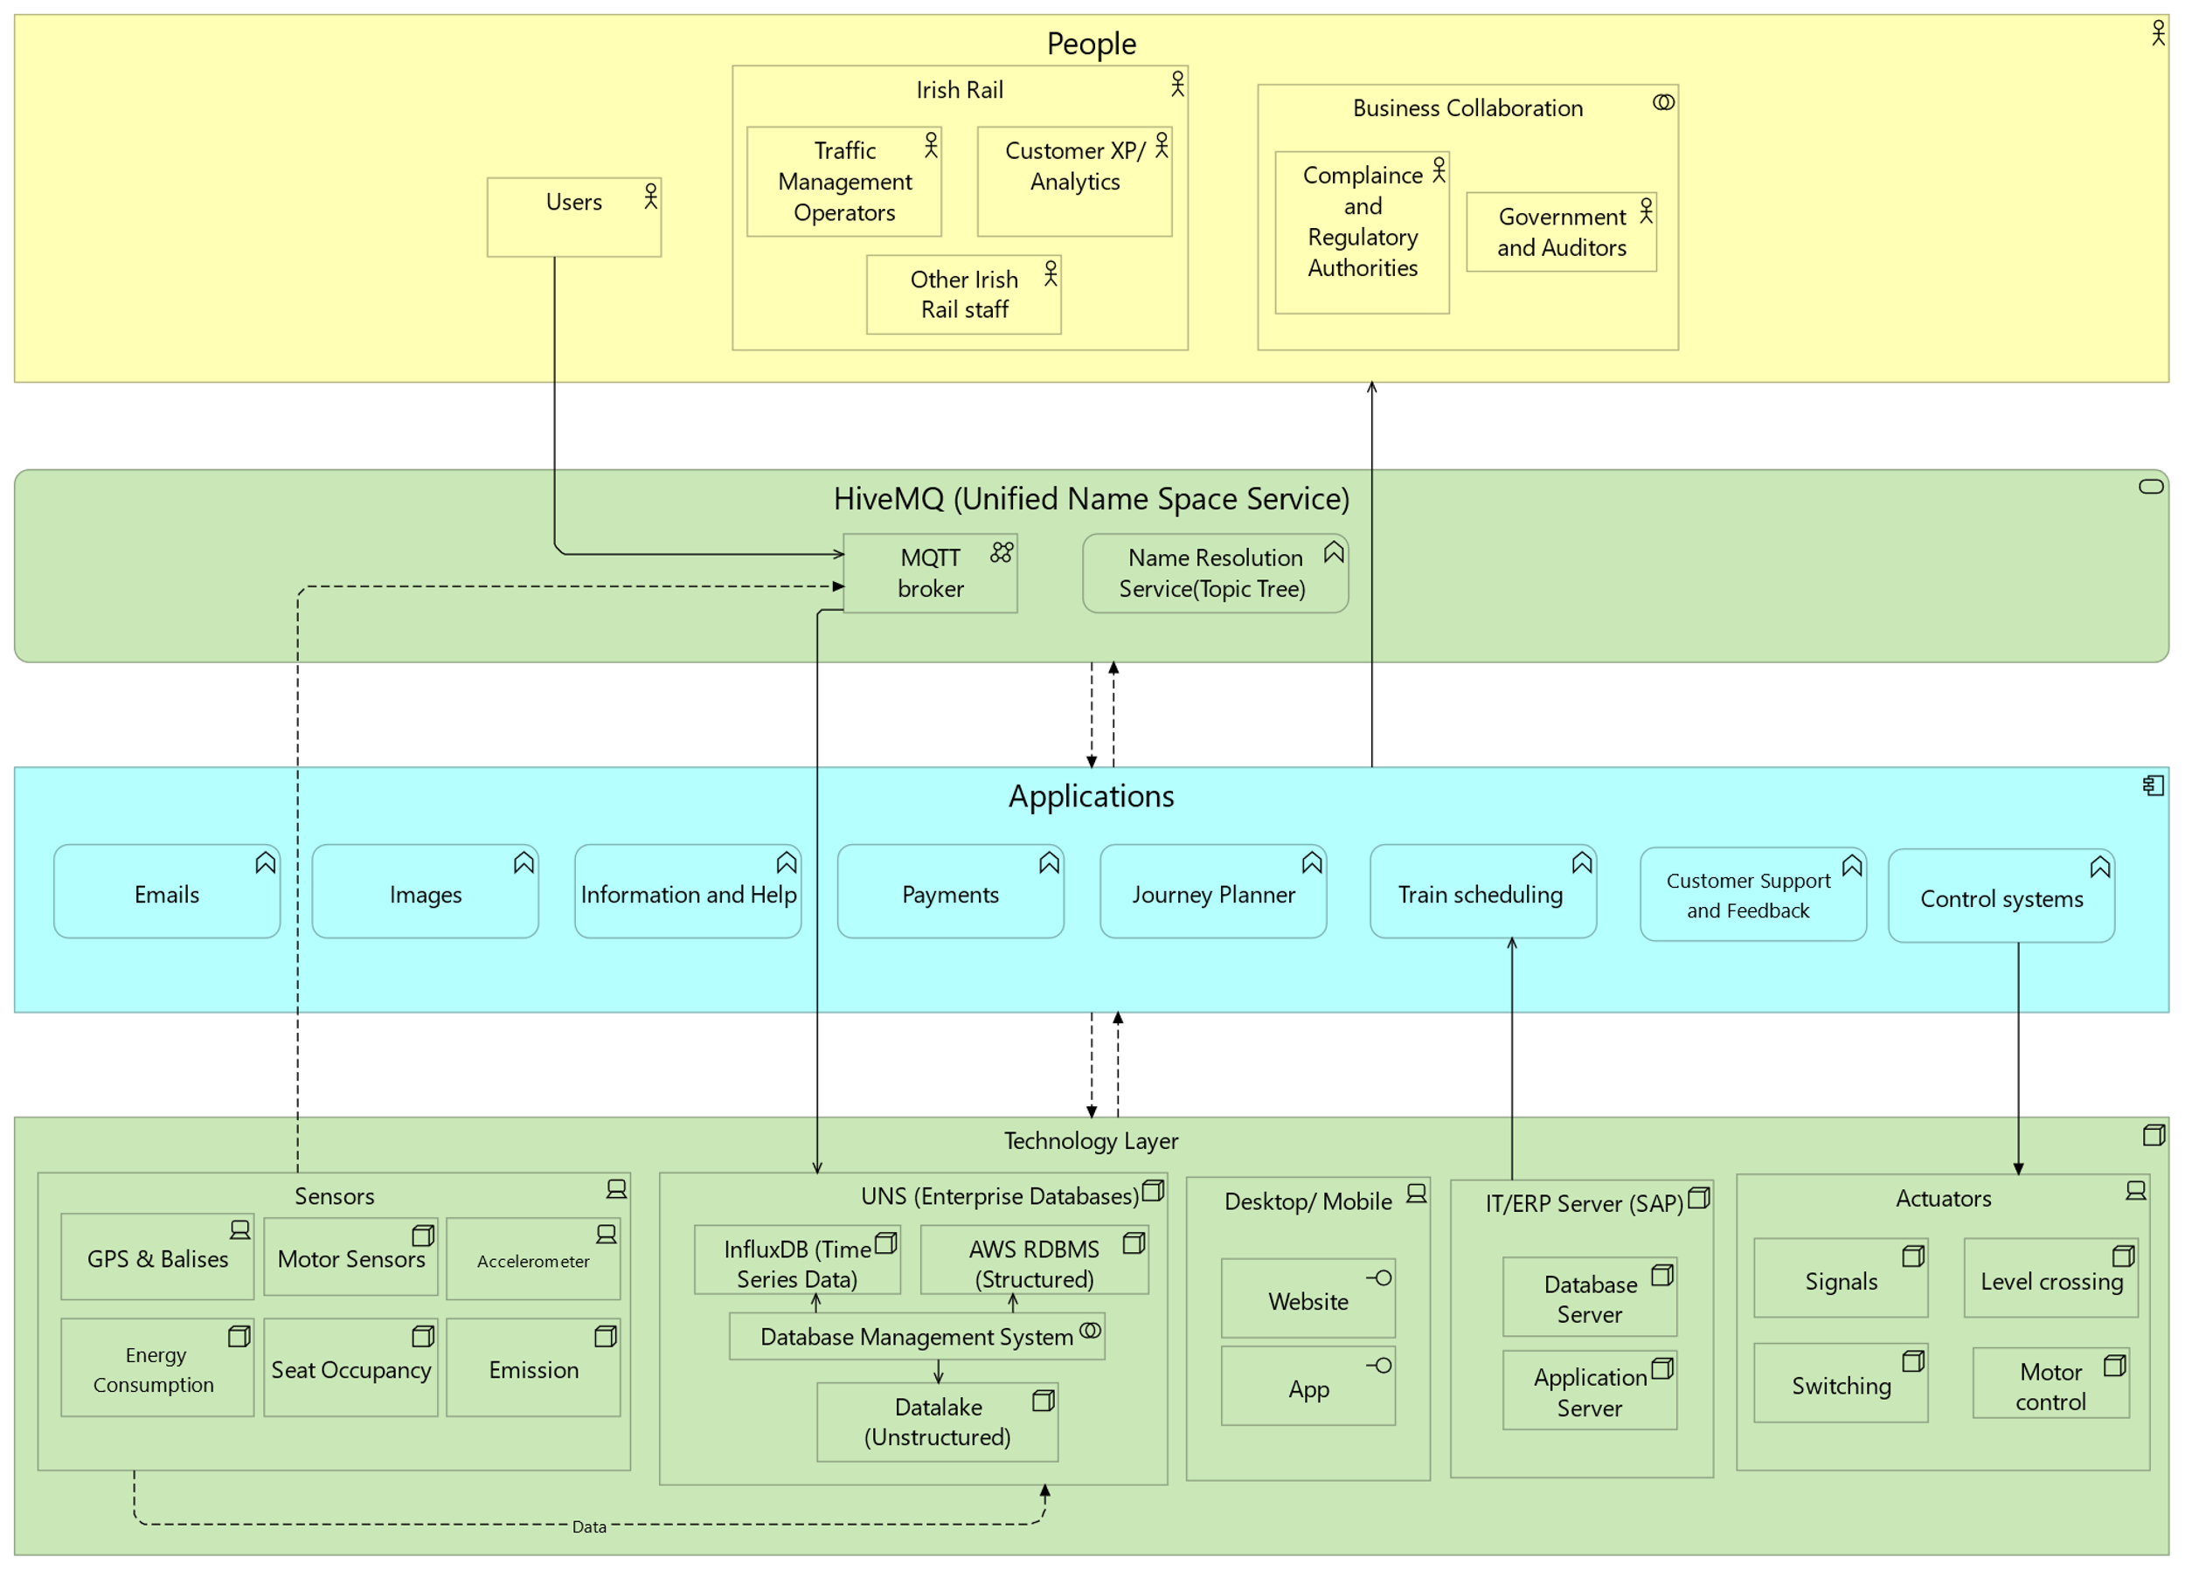
Application Architecture

Slide 20
Technology Architecture
Unified Namespace (UNS) built on HiveMQ & MQTT enables real-time, bi-directional communication across all systems.
InfluxDB handles high-speed time-series data from IoT sensors (speed, energy, occupancy).
AWS Aurora RDS stores structured data like ticketing, schedules, and pricing securely and reliably.
Amazon S3 Data Lake stores unstructured data (video, images, reports) with scalable archival via Glacier.
ISA-95 Semantic Hierarchy structures data into standardized layers (station → platform → sensors).
HiveMQ Edge bridges legacy protocols (Modbus, OPC-UA) into MQTT for seamless integration.
Real-time Dashboards & Analytics using Telegraf provide actionable insights for operators and staff.
Scalability & Flexibility through modular architecture supports AI integration and system expansion.
Cloud-Native Design ensures reliability, availability, and minimal downtime across the infrastructure.
Notes:
23 min
Technology Architecture focuses on defining the technology infrastructure needed to support business, data, and application services
We have proposed a technological architecture for the project by considering the pros and cons of all the available technologies. A detailed review is given in the executive report. We have chosen HiveMQ as the UNS service provider as is it is the industry standard. Its event driven architecture allows it to collect data from a wide range of sources IT and IoT.
Coming to the database elements most of them are cloud providers as they ensure scalability, elasticity and are fully managed. For the data lake we make use of Amazon S3 because of the different tiers and life cycle and retention policies it allows. S3 Glacier can be used to store data for long term and life cycle policies can be used to move data between S3 and S3 Glacier.
For the structured database we have AWS managed RDBMS such as Amazon Aurora or MySQL which are fully managed by AWS. We make use of Influx DB for the time series database due its massive write capability and high availability. SAP ERP, mention Siemens mobility and cubic transport for application services.

Slide 21
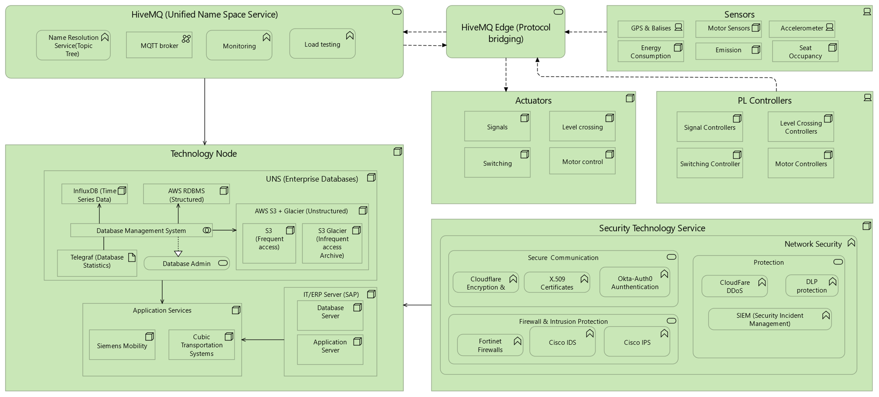
Technology Architecture
Notes:
PD, Kushaal (Backup)
Method of Approach for Technology Framework Selection:
Compared major vendors like AWS (Aurora, S3), HiveMQ, InfluxDB, and Oracle across key parameters:
Scalability: Cloud-native, horizontally scalable options preferred (e.g., AWS Aurora, InfluxDB Cloud).
Performance: Selected vendors offering low-latency, high-throughput solutions for real-time use cases.
Security & Compliance: Prioritized solutions supporting GDPR, ISO 27001, and NIS Directive standards.

Slide 22
Security Architecture
The Irish Rail Enterprise Security Architecture provides a comprehensive, layered approach to ensure the integrity, confidentiality, and availability of operational systems and data across the railway network.
The architecture integrates modern cybersecurity standards, operational control systems, secure communication protocols, and regulatory compliance mandates to protect critical rail infrastructure.
It is mainly split into 3 domains,
Governance and Regulatory Compliance
Identity and Access Management
Network Security and Segmentation
Notes:
This slide presents our Enterprise Security Architecture — a comprehensive and layered approach designed to protect the integrity, confidentiality, and availability of Irish Rail’s operational systems and data.
It’s built on modern cybersecurity principles and aligned with regulatory mandates to ensure secure and resilient rail infrastructure.
The architecture is structured into three main domains: Governance & Regulatory Compliance, Identity & Access Management, and Network Security & Segmentation.

Slide 23
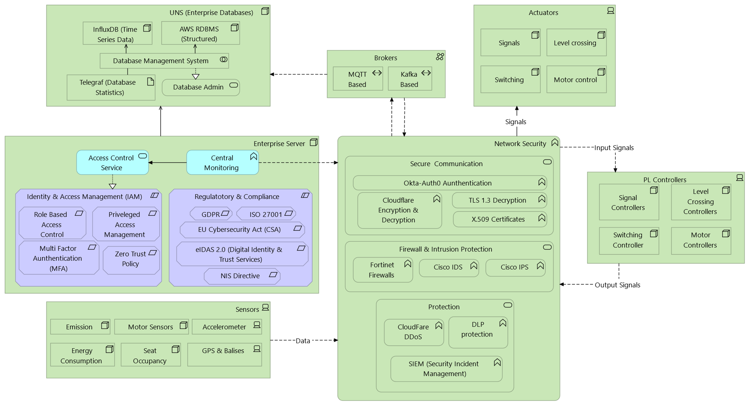
Notes:
At the heart of this architecture is the Enterprise Server, responsible for managing access control and central monitoring. It connects to various domains including sensors, databases, actuators, PL controllers, and brokers. These domains represent different functions in railway operations from data acquisition and control to real-time communication and automation.
Governance and Regulatory compliance :
This layer ensures our systems align with Irish and EU rail security regulations.
It governs data handling, system resilience, and ensures we’re regularly audited to stay compliant.“
IAM:
IAM is at the heart of controlling who gets access to what and utilize zero trust policies.
We use centralized authentication, enforce role-based access, and implement multi-factor authentication for critical systems.
Network Security:
This layer protects the network itself by segmenting operations from IT systems.
We deploy firewalls, secure gateways, and intrusion detection systems to isolate threats.
Real-time monitoring ensures rapid threat detection and response.
Together, these three layers form a robust, future-proof architecture that not only protects but also enables secure innovation within Irish Rail’s digital ecosystem.

Slide 24
Source Data policy
SDP is a supplementary architecture that we have proposed which is essential for such a huge data transformation. The source data policy is mainly concerned with how the data published by the source is processed and every change made to the data is tracked. The sources such IoT sensors and IT systems publish the data which is compliant to all the security standards as mentioned in the security architecture.
The data is produced in high frequency with only a single point being generated per unit time. So we have to Extract the data and then transform it into the required format and then load it push it onto a particular topic tree.
The databases which subscribe to the topic tree store the data and can be used for further processing. Lineage tracking which is about tracking all the changes made to the data at each step is achieved by using versioning in S3 buckets. The life cycle policies and retention are also key to ensure the data policies.
Notes:
To complement our enterprise architecture, we’ve proposed a supplementary component called the Source Data Policy, or SDP — which is essential for managing large-scale, high-frequency data transformation."
"SDP focuses on how source data is published, processed, and tracked. Data from sources like IoT sensors and IT systems is published in compliance with the security standards we’ve outlined in the overall architecture."
"Since the data is generated at high frequency, we follow an Extract-Transform-Load approach — extracting the raw data, transforming it into the desired format, and pushing it onto a structured topic tree."
"Databases subscribed to this topic tree then store the data for further analysis and use."
Kushaal Backup

Slide 25
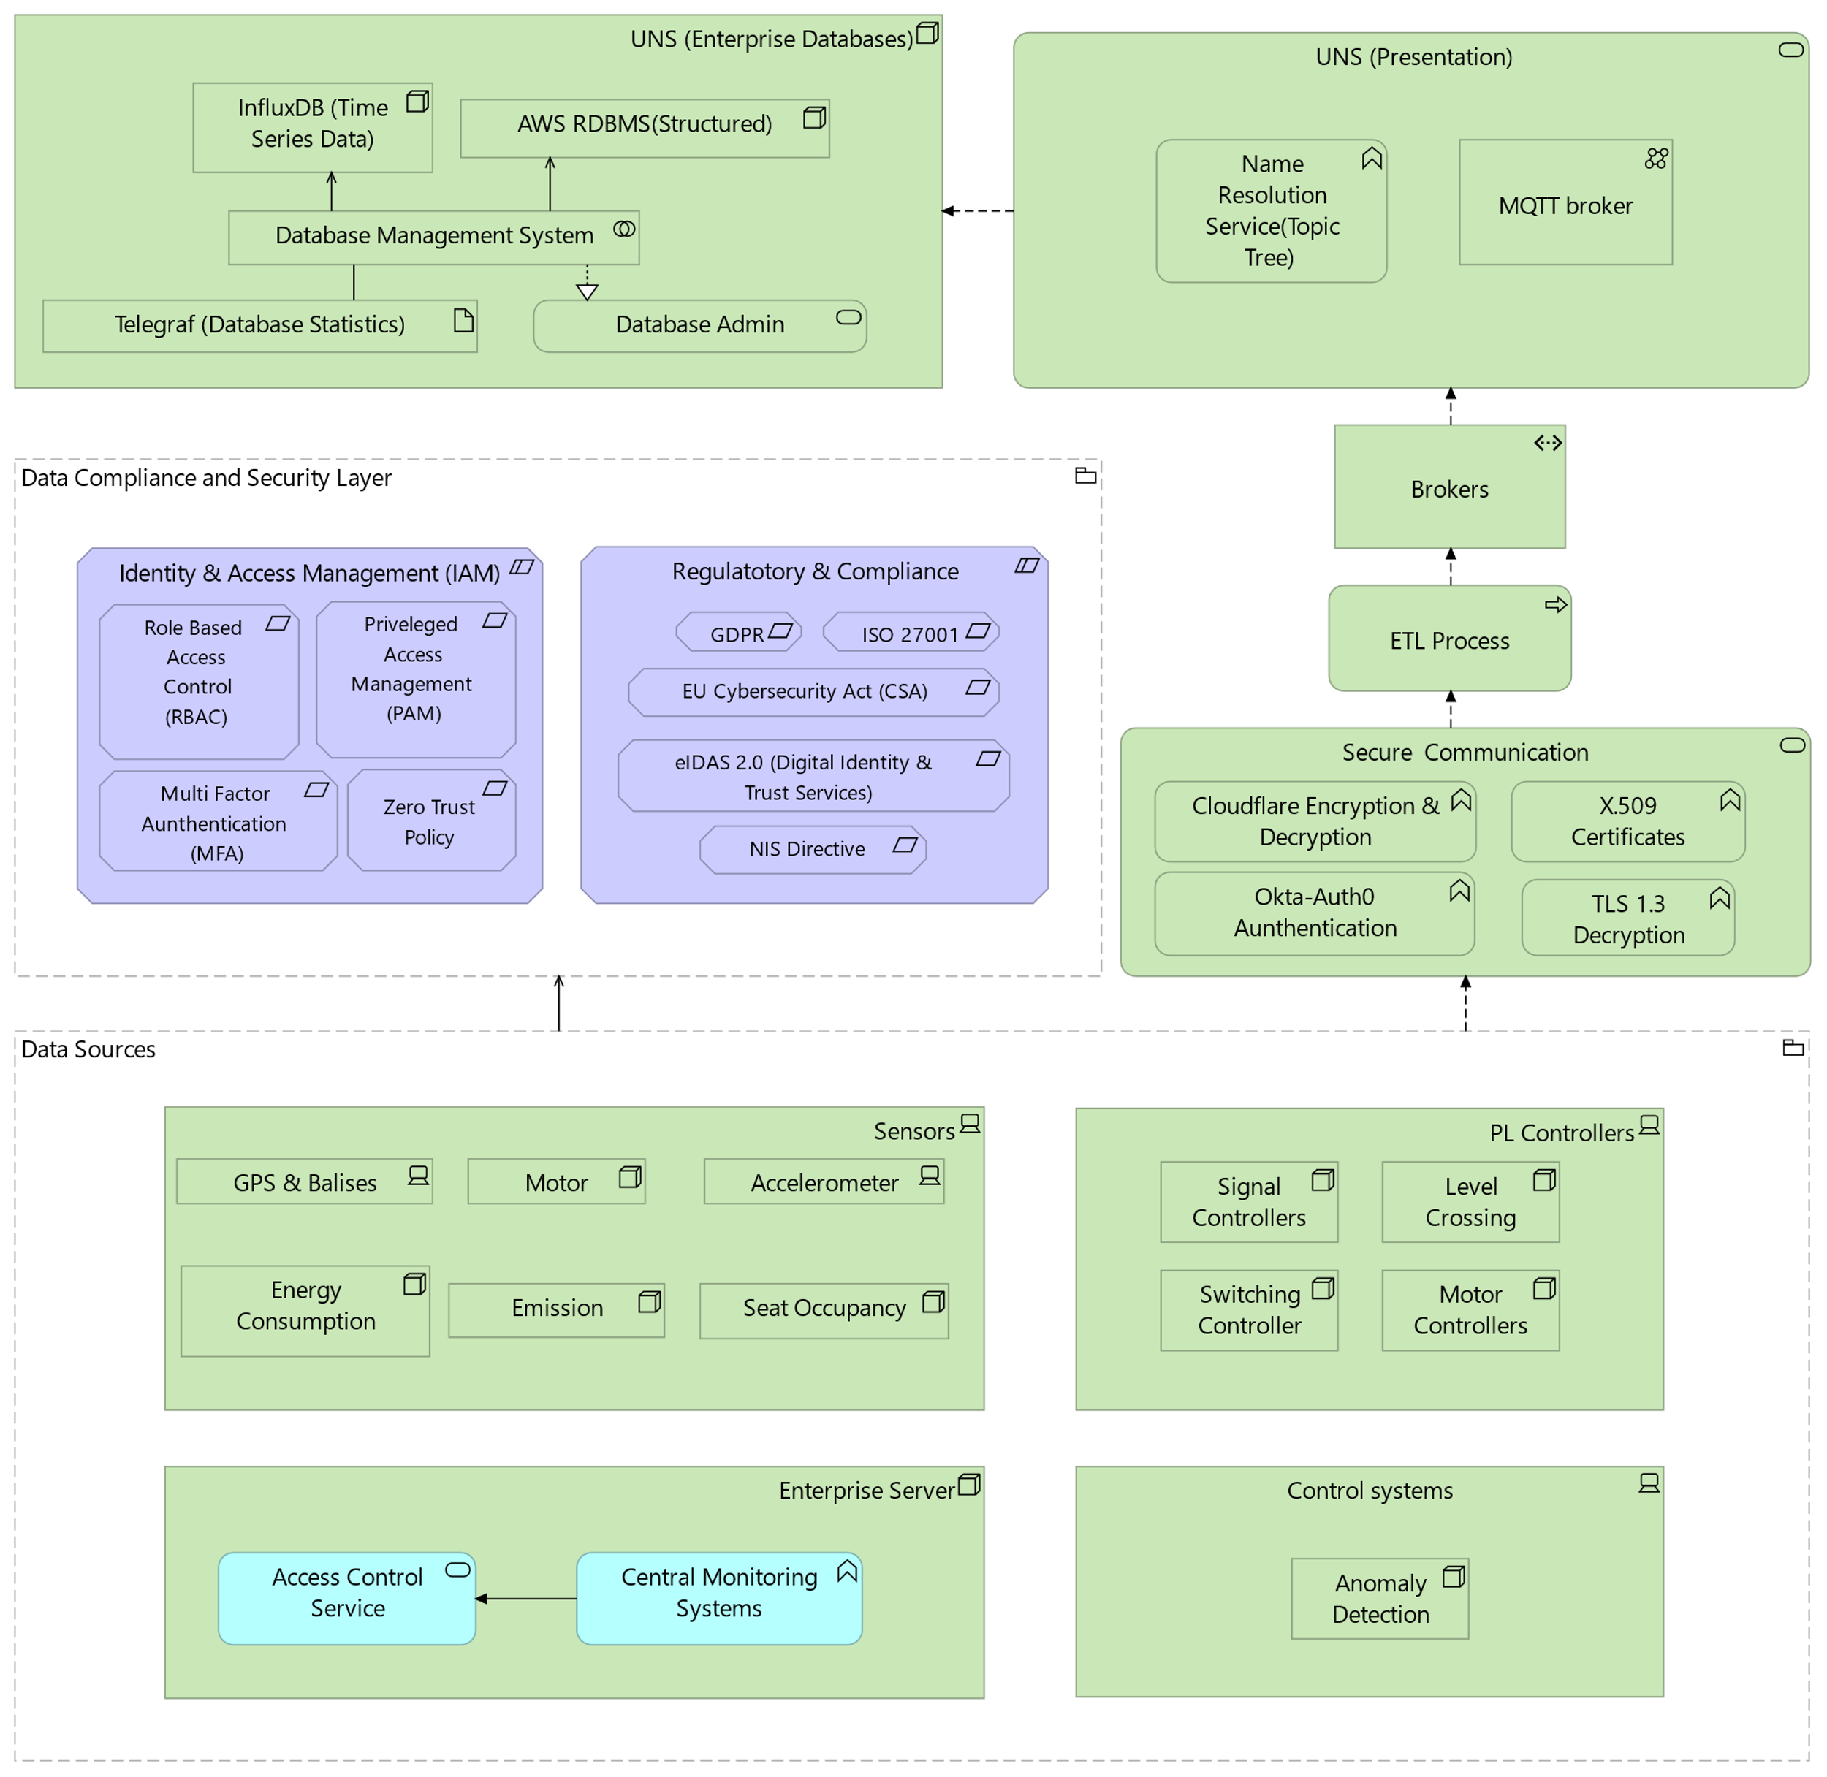
Source Data Policy
Notes:
Sensors generate binary or compressed data in high frequency.
Data needs decoding (e.g., binary to JSON).
Timestamp each record as it arrives.
Decode the sensor data to structured JSON format.
Ensure correct units & accuracy (e.g., GPS in decimal degrees, accelerometer in m/s²).
Use the unique identifier (dataId) to map readings to the correct train, station, or office.
Aggregate multiple sensor readings in a batch file.
Package each file into a JSON object.
At regular intervals, transmit the prepared file to the database. Use a secure protocol.
Define retention periods and archiving methods (e.g., real-time storage vs. long-term data lake).
Establish protocols for regular data purging and secure disposal.

Slide 26
Source Data policy
Data Collection (Raw Sensor Input)
Sensors generate binary or compressed data in high frequency.
Data needs decoding (e.g., binary to JSON).
Timestamp each record as it arrives.
Data coming from IT services and servers are preprocessed.
Data Transformation (Convert to Standardized JSON):
Decode the sensor data to structured JSON format.
Ensure correct units & accuracy (e.g., GPS in decimal degrees, accelerometer in m/s²).
Use the unique identifier (dataId) to map readings to the correct train, station, or office.
Aggregate multiple sensor readings in a batch file.
Package each file into a JSON object.
Transform the IT data.

Slide 27
Source Data policy
Data Transmission (Push to Database):
At regular intervals, transmit the prepared file to the database. Use a secure protocol like MQTT, HTTP API.
Interoperability & Integration
Ensure the data model supports integration across various systems (IoT sensors, enterprise apps).
Use a Unified Namespace to act as a single source of truth for consistent data access.
Compliance & Governance
Adhere to regulatory standards (e.g., GDPR, ISO 27001).
Create and enforce policies with a dedicated data governance committee.
Retention & Lifecycle Management
Define retention periods and archiving methods (e.g., real-time storage vs. long-term data lake).
Establish protocols for regular data purging and secure disposal.
Notes:
27 min

Slide 28
Cost Benefit Analysis
Individual Cost Breakdown by Scenario
Service / Component | Low Growth (5K devices) | Central Growth (50K devices) | High Growth (200K+ devices)
HiveMQ UNS | $10,000 | $20,000 | $40,000+
Amazon RDS | $2,000 | $5,000 | $15,000
Amazon S3 | $500 | $2,000 | $6,000
Amazon Glacier | $200 | $700 | $2,500
InfluxDB (Cloud) | $1,000 | $3,500 | $10,000
SAP ERP Licensing | $4,000 | $12,000 | $25,000+
SAP Training/Maintainence | $2,000 | $6,000 | $15,000
IoT Hardware (avg/month) | $5,000 | $10,000 | $25,000
Data Transfer (AWS) | $500 | $2,500 | $10,000
Growth Scenario | Estimated Monthly Total
Low Growth | ~$25,200
Central Growth | ~$61,700
High Growth | ~$148,500+
Notes:
• Users & Devices: oLow Growth: ~5,000 connected devices/users oCentral Growth: ~50,000 connected devices/users oHigh Growth: ~200,000+ connected devices/users

Slide 29
Cost Benefit Analysis
Annual Technology Opex Estimate: €688,572
One-Time Setup (Professional Services): €1–2 million
The proposed architecture is not just an IT investment—it's a strategic enabler for Irish Rail’s digital transformation. It delivers measurable ROI through operational gains, reduced downtime, improved compliance, and long-term agility.
Notes:
Operational Efficiency, Data-Driven Decisions, Semantic & Scalable Architecture, Enterprise Visibility, Long-Term Advantages

Slide 30
Risks and Mitigation
Risk Area | Specific Risks | Mitigation Plan
Resource Requirement | High resource demands for enabling technologies and data architecture setup | Staggered implementation, budget and procurement planning
Time Requirement | Long implementation timelines requiring consistent effort | Use of detailed timeline for phased technology planning
Legacy System Integration | Difficulty in integrating legacy systems into modern architecture | Use of protocol bridges; phased migration to new technologies
Stakeholder Resistance | Reluctance or lack of buy-in from stakeholders | Effective communication of benefits, structured knowledge transfer
Technical Failures | Reliability issues and possible technology failures | Use of redundant systems; procurement from reliable, proven vendors
Notes:
Rohan

Slide 31
Timeline
Month | Phase | Milestone
1 | Step 1: IT Infrastructure Setup | Provision cloud services (Aurora, S3, InfluxDB, HiveMQ) Deploy virtual environments and simulate sensors
2 |  | Complete system integration of services (Cloudflare, Okta, Fortinet)
3-4 |  | Conduct load and stress testing; optimize based on feedback
4 |  | Validate simulated environment against real use cases
4 | Step 2: Physical Sensor Deployment | Finalize procurement of IoT sensor hardware and edge devices (HiveMQ Edge)
5 |  | Begin sensor installation on selected pilot routes
5-6 |  | Complete commissioning and test real-time data streams
6-7 | Step 3: Integration and Scaling | Integrate live sensor feeds into cloud IT stack
7-8 |  | Monitor performance and uptime across end-to-end system
9-10 |  | Conduct full system go-live across all routes and issue operational report
Notes:
Kushaal Backup 30 min
Our implementation plan is structured into three key phases over a 10-month period: IT Infrastructure Setup, Physical Sensor Deployment, and Integration & Scaling.
We begin by provisioning cloud services and simulating sensor environments, followed by system integration, load testing, and validation against real use cases
Next, we procure IoT hardware, install sensors on pilot routes, and test live data streams to ensure real-time performance.
Finally, we integrate sensor data into the IT stack, monitor system uptime, and roll out full deployment with an operational report.

Slide 32
Outcomes
Single source of truth for all data produced by the Irish rail. This data system should be accessible across the Irish rail enterprise.
Interoperability of different types of data. Existing systems using different communication protocols will be able to communicate with each other using the central interface.
Efficient classification of data within the data systems to ensure accurate and seamless data publishing and retrieval with minimal overhead.
Notes:
The Irish Rail Enterprise Architecture initiative was designed to bring cohesion, clarity, and control across the entire digital landscape of the organization. A major outcome is the creation of a single, reliable data source — a foundation for trusted, organization-wide decision-making
This enables seamless communication across various operational and legacy systems through a unified interface, breaking down historic silos.
All teams — from operations to strategy — now have structured, governed access to the information they need, when they need it.
Finally, we’ve introduced a standardized architectural framework, grounded in best practices, that ensures Irish Rail is future-ready — able to scale securely and meet evolving compliance needs
These outcomes together lay the groundwork for a resilient, integrated, and agile digital ecosystem across Irish Rail.

Slide 33
Conclusion
This project presents a conceptual Enterprise Reference Architecture that aims to support Irish Rail’s ongoing digital evolution. By leveraging TOGAF principles and introducing a Unified Namespace using HiveMQ and MQTT, the architecture demonstrates how seamless interoperability can be achieved across diverse systems. With features like semantic hierarchies, secure data pipelines, and modular scalability, the proposed framework offers a structured approach to enhancing real-time visibility, operational efficiency, and long-term adaptability. While developed in an academic context, this architecture reflects current best practices and may offer valuable insights for future enterprise-level innovations.
Notes:
As Irish Rail continues its digital transformation, managing diverse and growing data streams becomes increasingly important. To support this, we’ve proposed a TOGAF-aligned Enterprise Reference Architecture."
"At its core is a Unified Namespace ,enabling seamless communication across both legacy and modern systems."
"With semantic hierarchies, secure pipelines, and modular scalability, the architecture supports real-time visibility and long-term adaptability."
"This offers a practical framework to inform future enterprise-level innovations."

Slide 34
THANK YOU We sincerely thank The Open Group for the foundational guidance, the Irish Rail mentors for their domain expertise and feedback, and the Bruhati mentors for their continuous support and encouragement throughout this project.
Notes:
As Irish Rail continues its digital transformation, managing diverse and growing data streams becomes increasingly important. To support this, we’ve proposed a TOGAF-aligned Enterprise Reference Architecture."
"At its core is a Unified Namespace ,enabling seamless communication across both legacy and modern systems."
"With semantic hierarchies, secure pipelines, and modular scalability, the architecture supports real-time visibility and long-term adaptability."
"This offers a practical framework to inform future enterprise-level innovations."

